Slide 1
Tuvalu Project 2017 Designing a Pavilion Website for the Venice Biennale "Climate Canary”

Slide 2
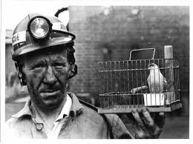
“Canary in a Coal Mine” (Symbol of Warning)

Slide 3

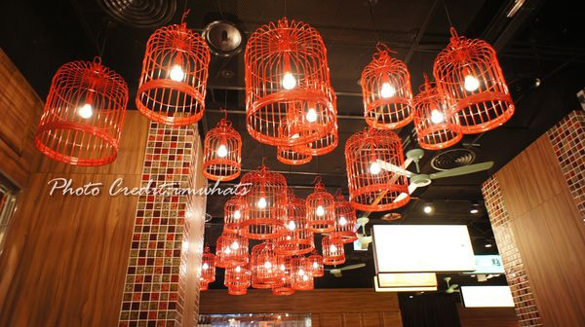
One basic motif: birdcages with light feature

Slide 4
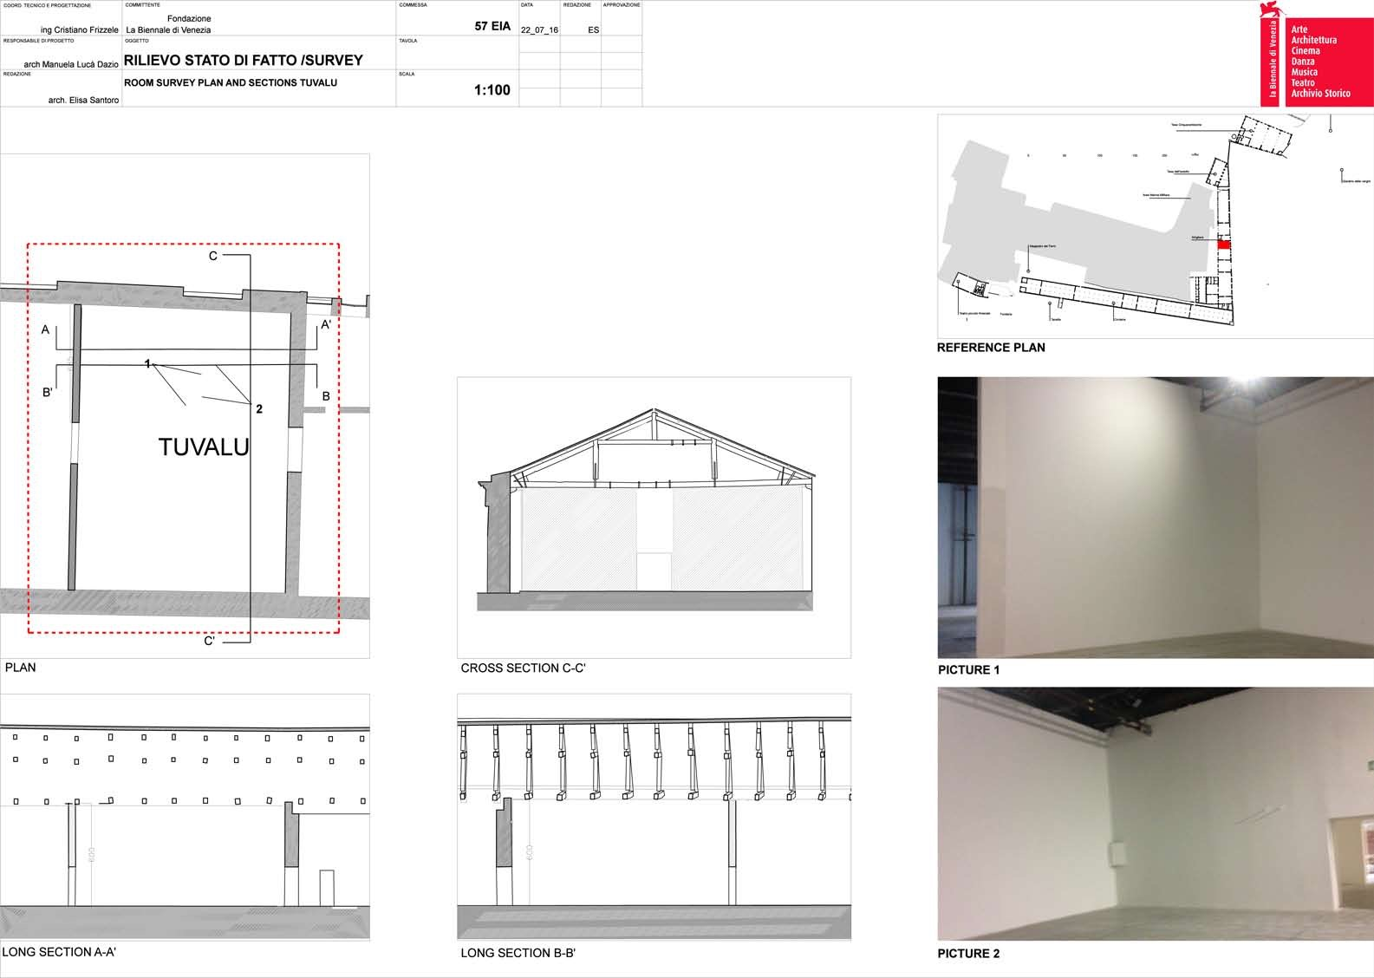
Venice Biennale Installation space

Slide 5
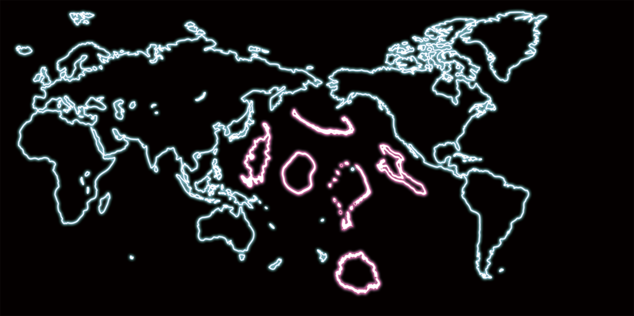
On one of the large walls: Redrawn map of the World

Slide 6
Main Themes for both Exhibition and Website
Art and Eco-activism
Environment Justice for Small Countries
World Food Security

Slide 7
Our Project Goal: Create a website to be the online reference to the actual exhibition and more.
What’s more?
Present context and explanations
Attract donors
Create the sense of global engagement
Create a website that can live beyond the exhibition

Slide 8
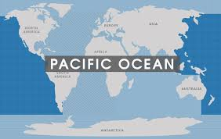
Pacific: Largest Geological Feature in the World

Slide 9
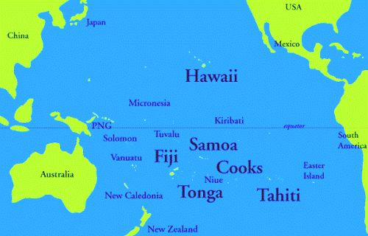
Pacific Island Countries (mostly just dots on the standard world map)

Slide 10
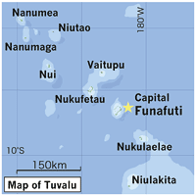
Tuvalu’s capital Funafuti, population 6000

Slide 11
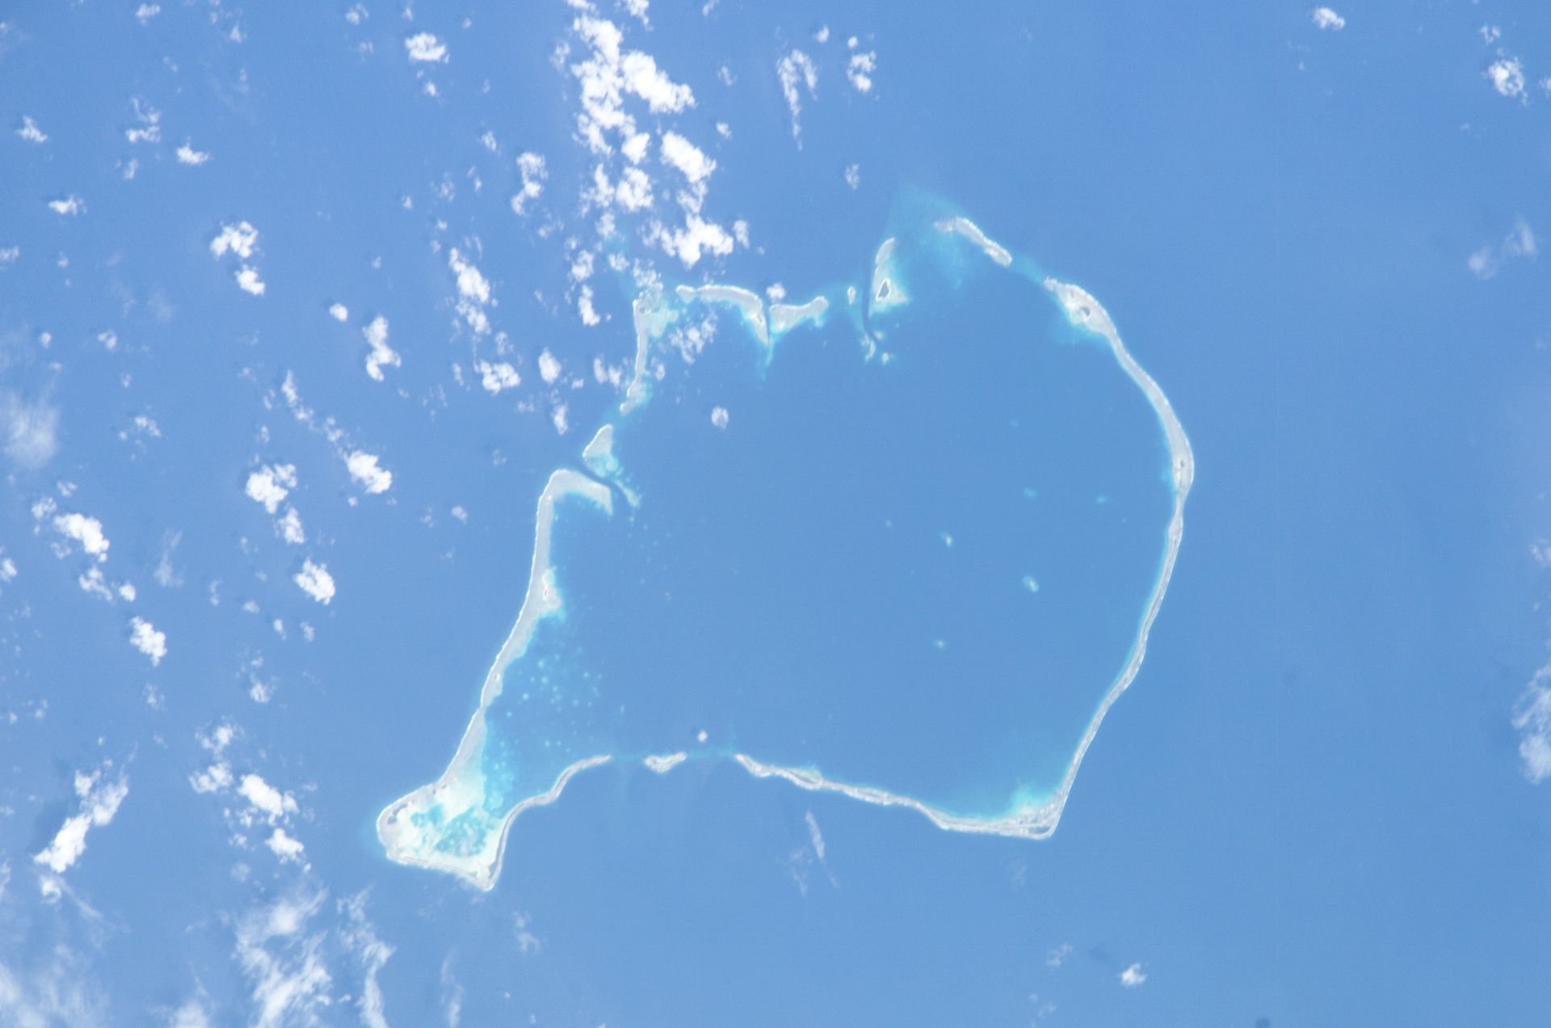
Funafuti

Slide 12
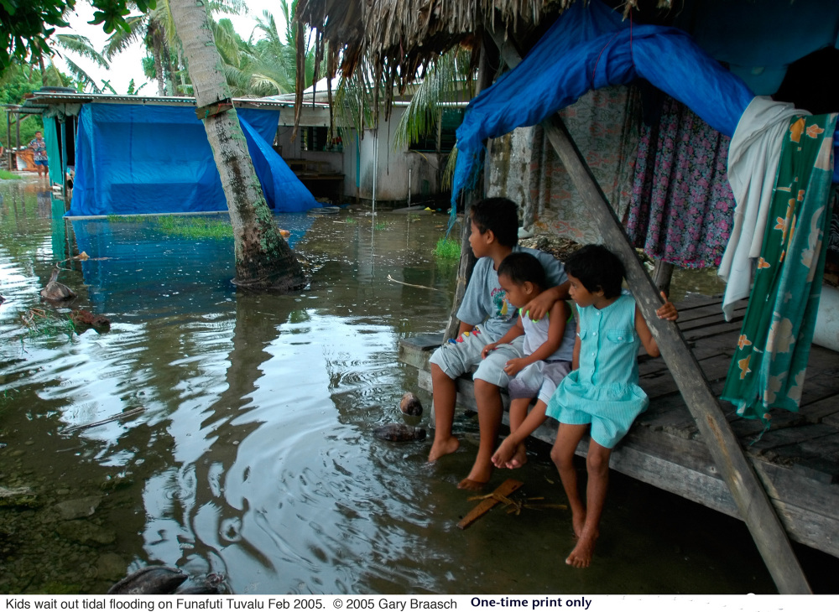
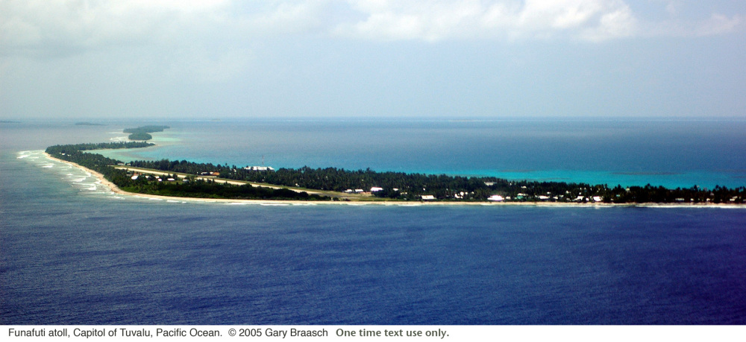
Storm surges and Sea-Level Rise threaten livelihood; there is no high ground to escape to.
https://islandsfirst.wordpress.com/2008/06/17/funafuti/ （accessed Jan 26, 2017)

Slide 13
Investigation 1:
What are the cultures of the Pacific Islands and Tuvalu especially?

Slide 14
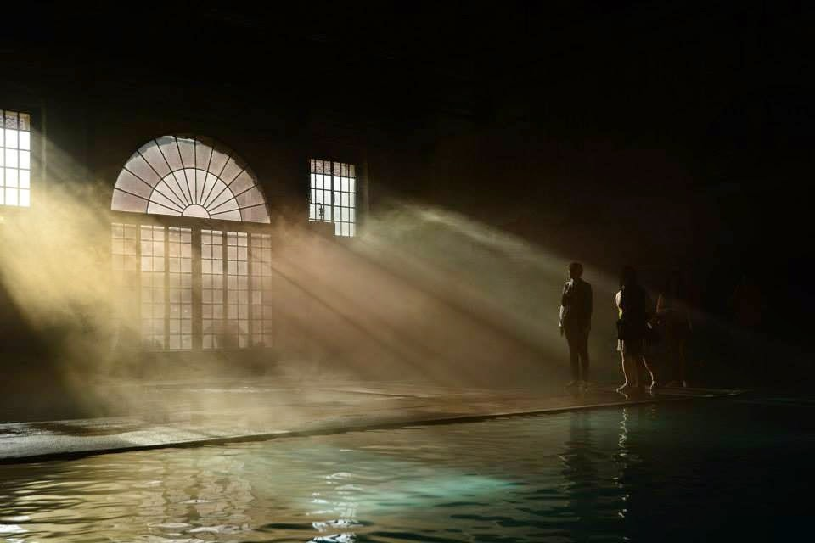
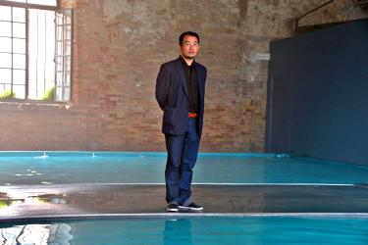
Artist Vincent Huang (Taiwanese) for Tuvalu Pavilion at VB 2015 “Crossing the Tide”

Slide 15
About Vincent J.F. Huang (From 2017 VB Press Release)
1971 Born in Nantou, Taiwan
2001 MFA Gray’s School of Art
2001-2006 Taught at Shu-te University, Kaohsiung
Artists-in-Residence in Japan, Mainland China, Australia
2012 Represented Tuvalu at the UN Climate Summit
2013 & 2015 Venice Biennale for Tuvalu
2013 Taiwan’s Presidential Cultural Award

Slide 16
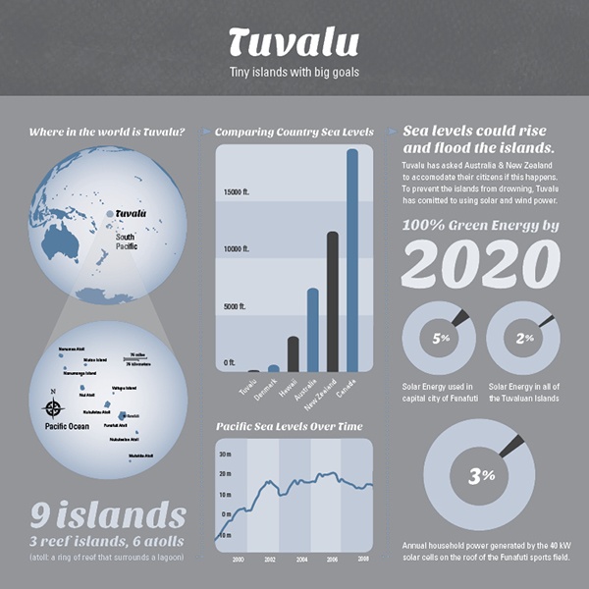
9 Islands of Tuvalu: 3 reef islands & 6 atolls (coral reef rings that form a land mass)
Crisis and Approach (limit CO2 emission)
Source: https://www.behance.net/gallery/13553483/Tuvalu-Infographic (accessed Jan 26, 2017)

Slide 17
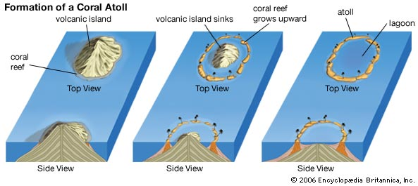
Formation of an Atoll

Slide 18
Investigation 2
What is the nature of atolls? Why have coral reefs formed around sunken volcanic mountains?
Is the graph of Pacific Island sea-level rise in the previous graph accurate? Track changes going back several decades.

Slide 19
Tuvalu switching to Green Energy will not solve the problem without participation from the big consumers, most advanced industrialized countries. Climate justice for small nations. Think transnational responsibility.

Slide 20
Book to read:
Prasenjit Duara, The Crisis of Global Modernity: Asian Traditions and a Sustainable Future (2014)

Slide 21
Climate Denier’s view Posted on the internet in 2010 by Willis Eschenbach (B.A. in Psychology)
“Does increased CO2 cause increased sea level rise?
Short answer, data to date says no. ”
“Regarding atolls and sea level rise, the most important fact was discovered by none other than Charles Darwin. He realized that coral atolls essentially ‘float’ on the surface of the sea. When the sea rises, the atoll rises with it. They are not solid, like a rock island. They are a pile of sand and rubble. There is always material added and material being lost….The result is that the atoll rises with the sea level.”
Source: https://wattsupwiththat.com/2010/01/27/floating-islands/ (access Jan 26, 2017)

Slide 22
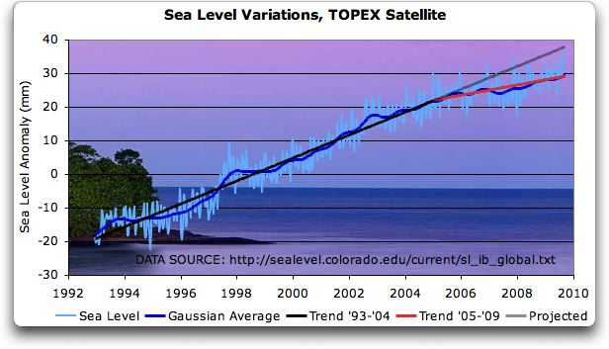
Graph posted by Eschenbach who argues that sea-level rise has slowed down.

Slide 23
Investigation 3:
Does CO2 emission cause sea-level rise?
If so, give data and examples (esp. transcultural effects).
How does that actually affect coral atolls? Do they just float up with the water?

Slide 24
Basic Components of the Exhibition
Re-drawn map of the world on the main wall, especially highlighting endangered places and scaling the level of crisis (also website’s homepage)
Bird Cage with lit, colorful foodstuffs with the Tuvalu Pulaka as the centerpiece
list of donating nations projected on one wall (website with capability to record donors’ national affiliations)

Slide 25
Project Homepage (also as mural in exhibition): Redrawn map of the World (Pacific Islands enlarged to symbolize the size of their crisis)

Slide 26
Priority 1: Website Homepage Research and Design this map

Slide 27
Map: 1. Scaled to data set (several seconds of morphing from “normal” map?) 2. Spotlight Venice and Tuvalu for clicking (e.g. using canary as icon)

Slide 28
Priority 2: Create Content and Insert Images for next page (Exhibition, Scenes of Tuvalu)

Slide 29
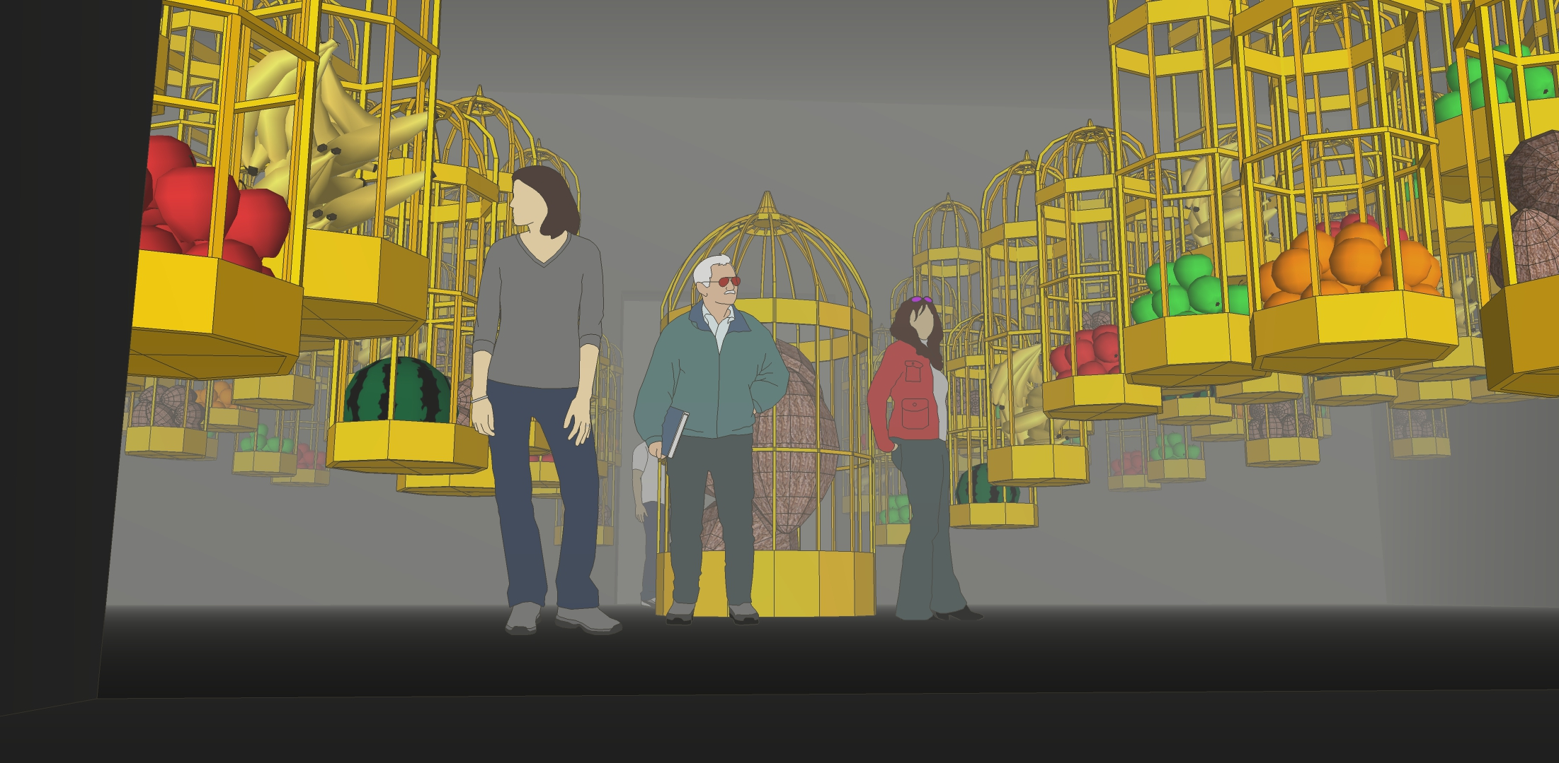
Venice: Exhibition simulation; access info on select endangered international foodstuffs by clicking on individual cages

Slide 30
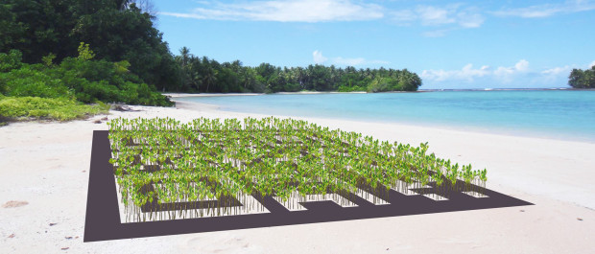
Tuvalu: What we will see after clicking it on the map: example (Huang’s mangrove project)

Slide 31
Mangrove Project: We hope to plant over 7,000 mangroves on the coasts [of] Tuvalu, to form a giant QR code shape. By scan[ning] this QR code you‘ll be linked to more relevant information about global climate change and sea level rising. As Joseph Beuys’s 7,000 oak‘s project in 1981 in Kassel, Germany, we transfer this idea [to] plant[ing] mangroves in Tuvalu. https://www.indiegogo.com/projects/art-mangroves-project-in-tuvalu-environment#/ (accessed Jan 26, 2017)

Slide 32
Priority 3: Create Donation feature

Slide 33
Priority 4: Insert other environmental information, e.g. Climate Change and Food Crisis Explained

Slide 34
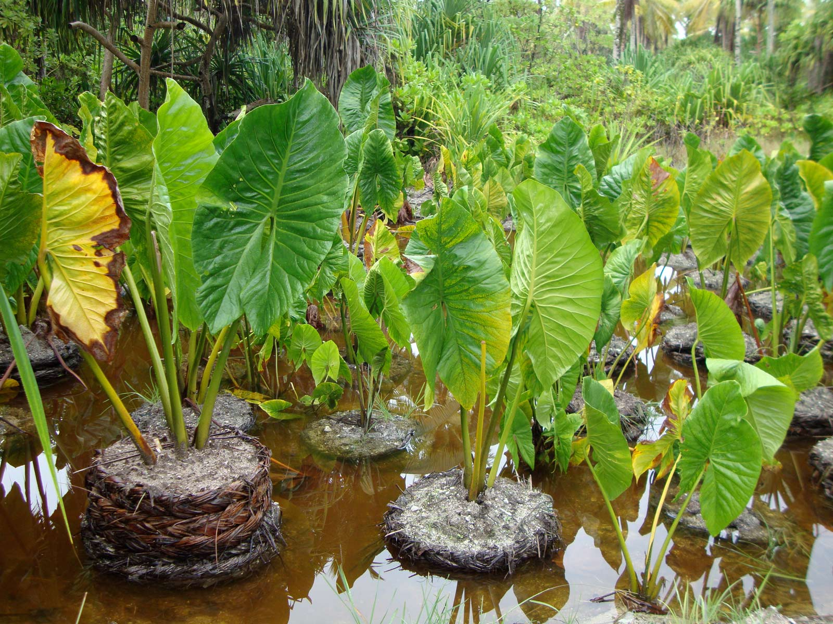
Tuvalu Pulaka (a type of swamp taro), major source of carbohydrates (endangered by sea-level rise)

Slide 35
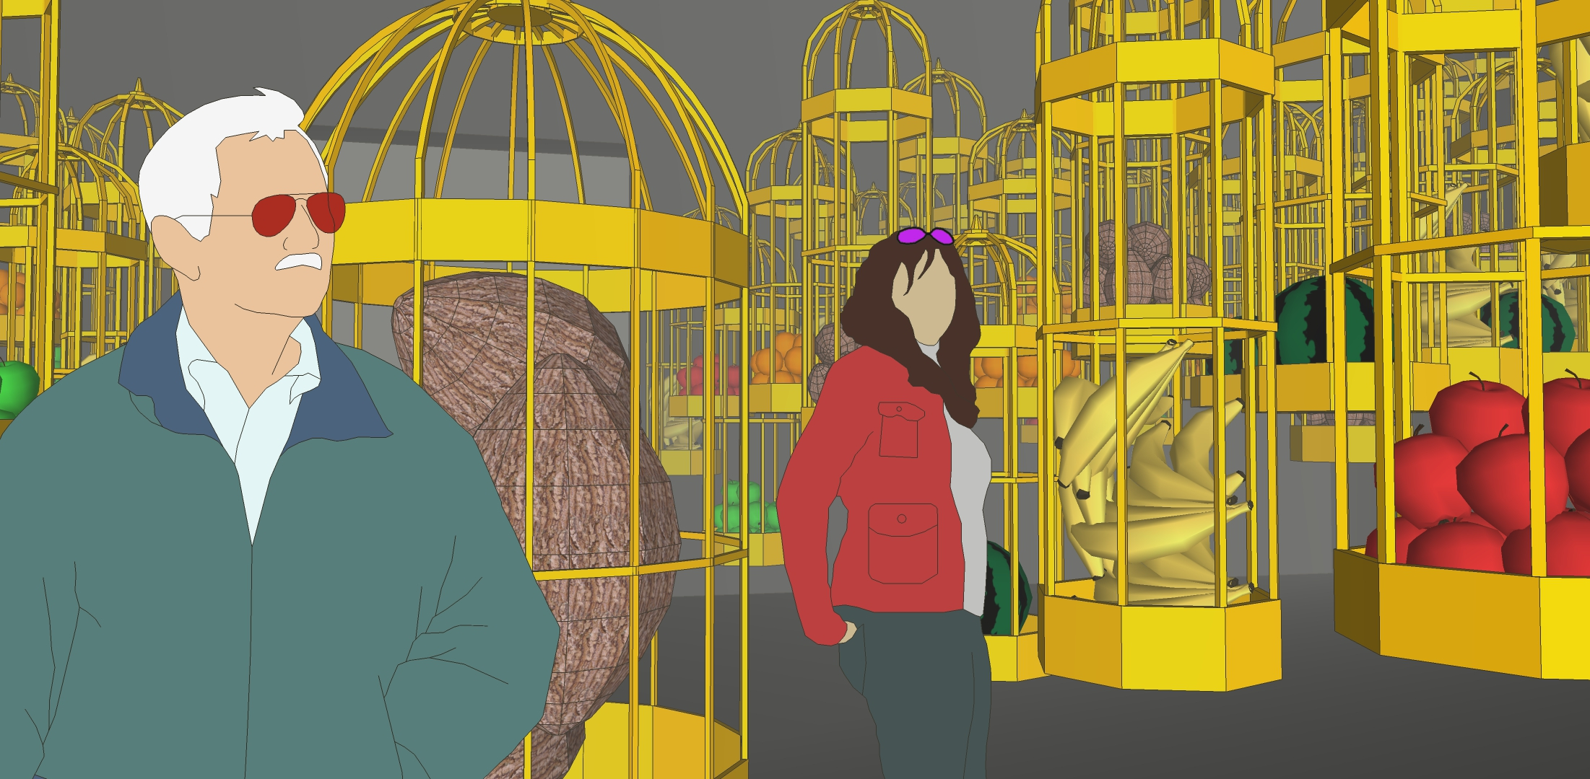
Pulaka rotting (simulate decay process by scientific imaging) for exhibition projection

Slide 36
More advanced tasks:

Slide 37
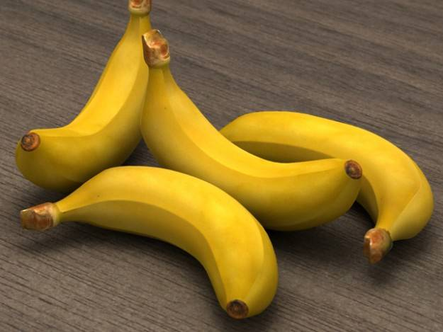
3-D Printing of Endangered Foodstuffs from different parts of the world (multicolor)

Slide 38
Simulate Flood of atolls (using physics )

Slide 39
Project First Step: Division of Labor & Collaboration (Individual and Team work)

